Slide 1



Webscraping and Sentiment Analysis from reviews of TripAdvisor
by Sergi Alvarez Guasch
March 2022

Slide 2
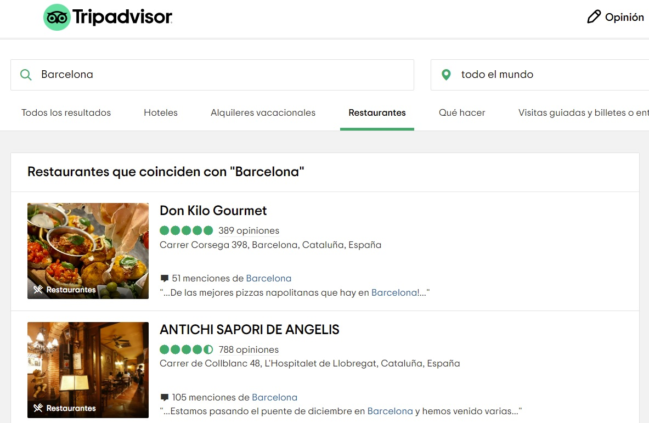
Webscraping

Slide 3
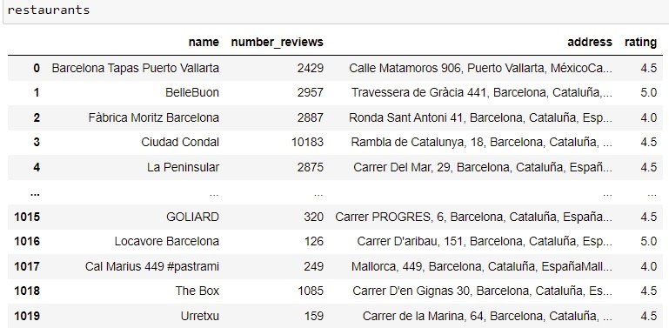
Geocoding
Get the restaurant with the greatest number of reviews
Cleaning Steps
Geocoding

Slide 4
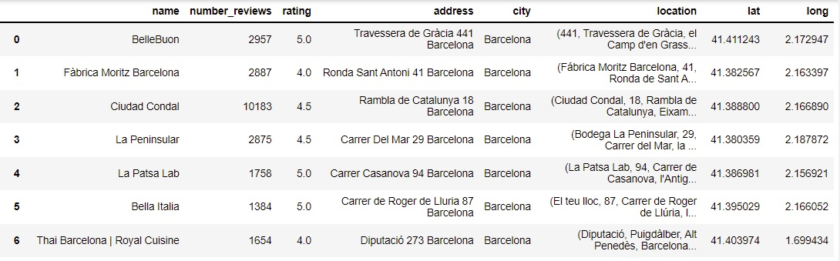
Mapping
Maps/Analysis

Slide 5
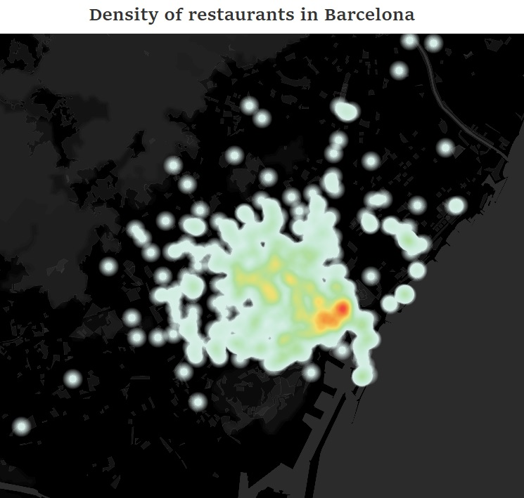

Slide 6
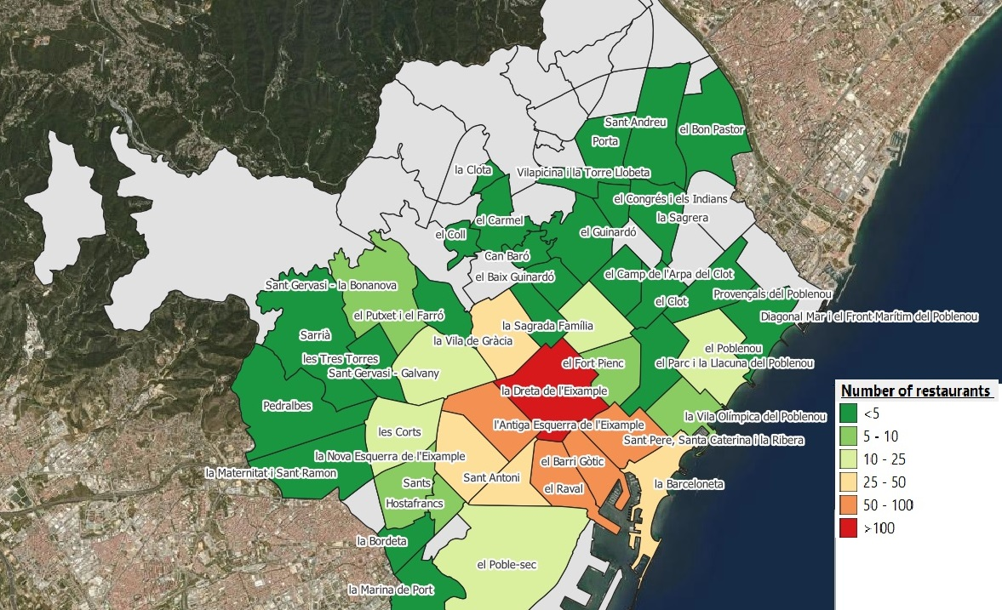
Number of restaurants by neighborhood
Total: 698

Slide 7
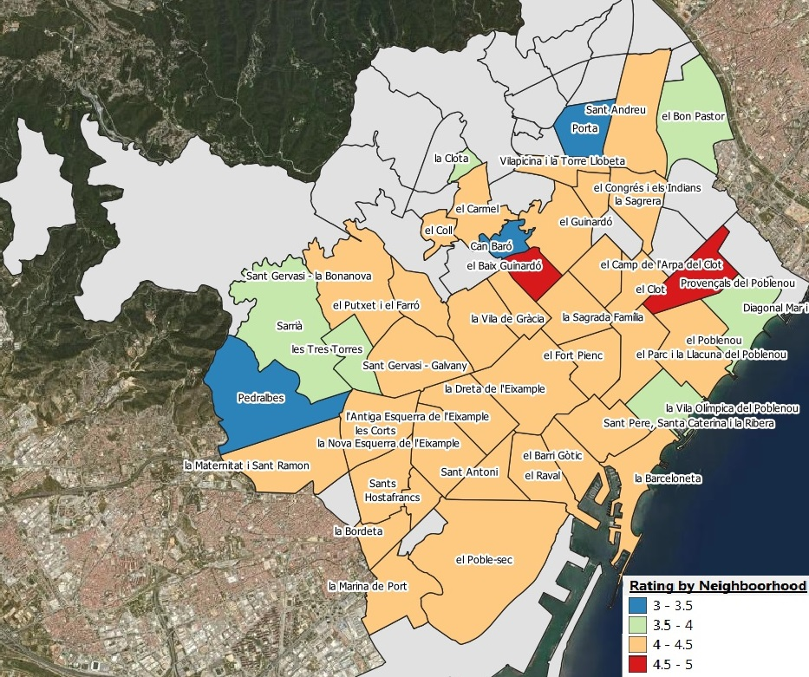
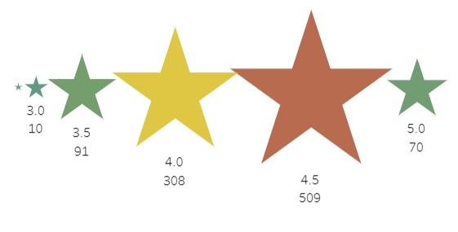
Mean rating review restaurants by neighborhood
Rating of restaurants

Slide 8
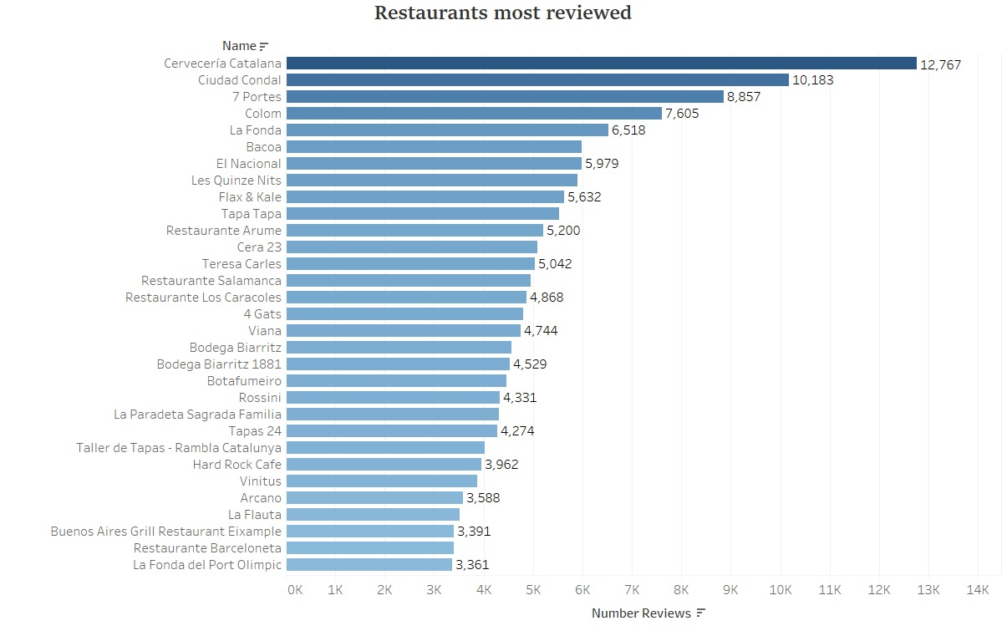

Slide 9
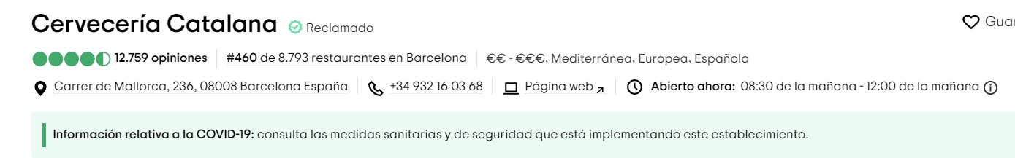
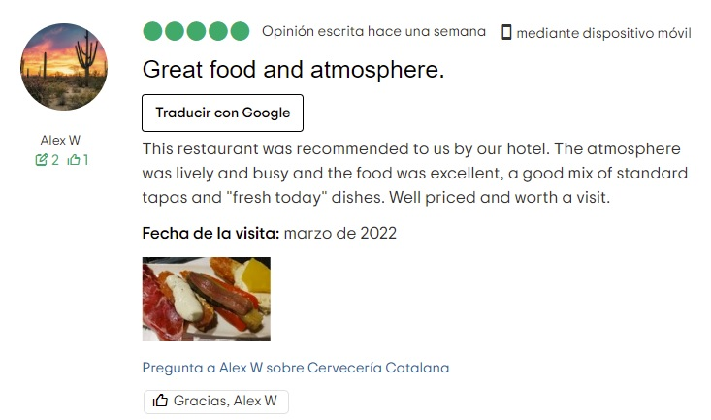
Webscraping

Slide 10
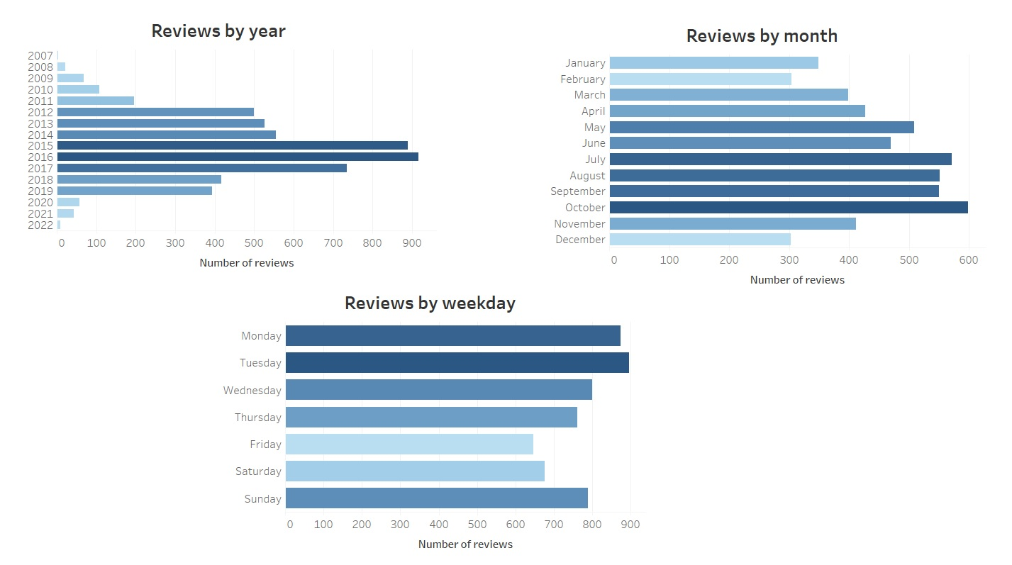

Slide 11
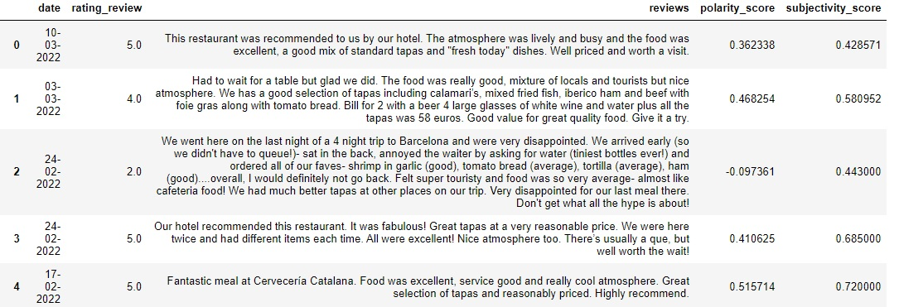
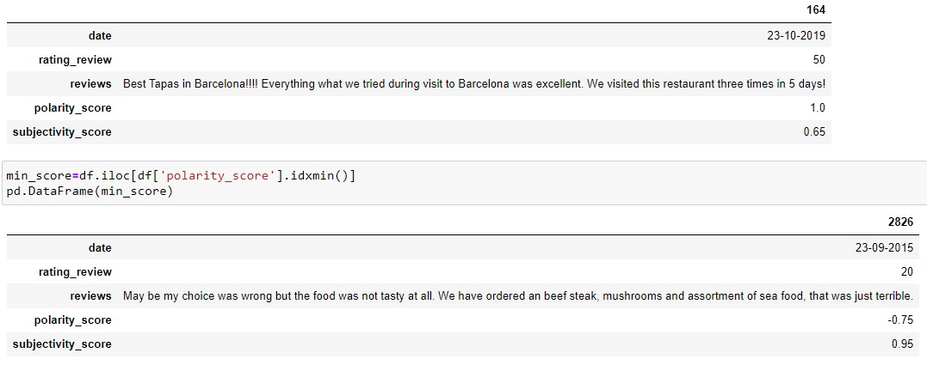
Sentimental Analysis
Polarity and Subjectivity of reviews
Mean Polarity: 0.33 --- 66,5% positive
Mean Ratings: 4.43 --- 88,6% positive

Slide 12
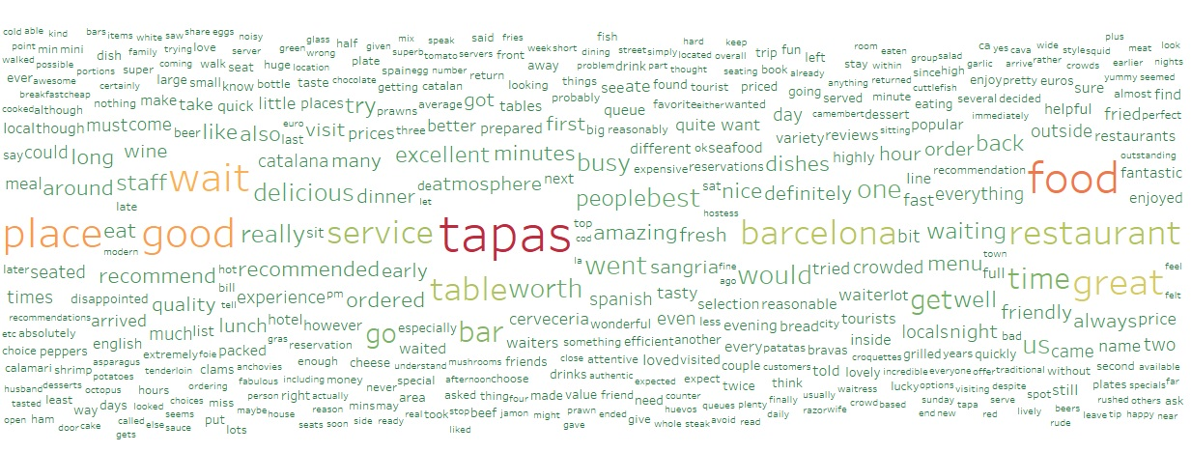
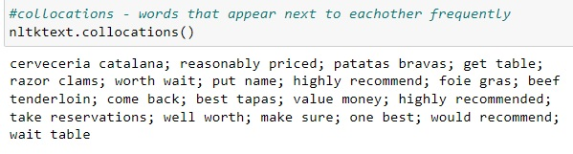

Sentimental Analysis
Most frequency words in the reviews

Slide 13
Thank you!

